Slide 1
Data Analysis of International Supermarket

Slide 2
About Dataset
This dataset is downloaded from Kaggle.com, uploaded by GoKagglers which was updated 2 years ago.
The dataset contain information about retail sales for a superstore that has branches globally.
It has information for 4 years from 2011-2014 (1st Jan 2011-12th Dec 2014).
Dataset has 1 excel file in which there is 23 column and among this columns is 15 in string, 4 in decimal, 2 in date-time and 2 in integer format.
It has 51291 rows of data.

Slide 3
Problem Statements and the results:
Does sales and quantity brought by customers grows proportionally. ->So after the analysis I found that for most of the customers quantity brought is proportional to the sales.
What is the shipping cost per year for each order priority? ->The analysis give us the information that each year shipping cost increases and medium order priority has the most shipping cost irrelevant to years.
Which are the top regions that ordered the most quantities? ->From the analysis I found that central region has ordered the most and consumers segment products was sold the highest.

Slide 4
Show the sales trend line. ->This analysis was the most important as it show the growth of the company along this years, so the result was in 2012 the sales was lower then 2011 but sales increased rapidly in 2013 and more in 2014.
Which markets has sold product for more then $500K? ->This gives us the markets Africa, APAC, EMEA, EU, LATAM and US.
Which are the top countries to spend the most amount of money buying from the superstore? ->This analysis yield that United States has spend the most, 2M+ and after US, Australia has spend 900K+.
Link -https://drive.google.com/drive/folders/1DUinJhJ0cY4DmJzVuSpUAq7rXlL4iCId?usp=sharing

Slide 5
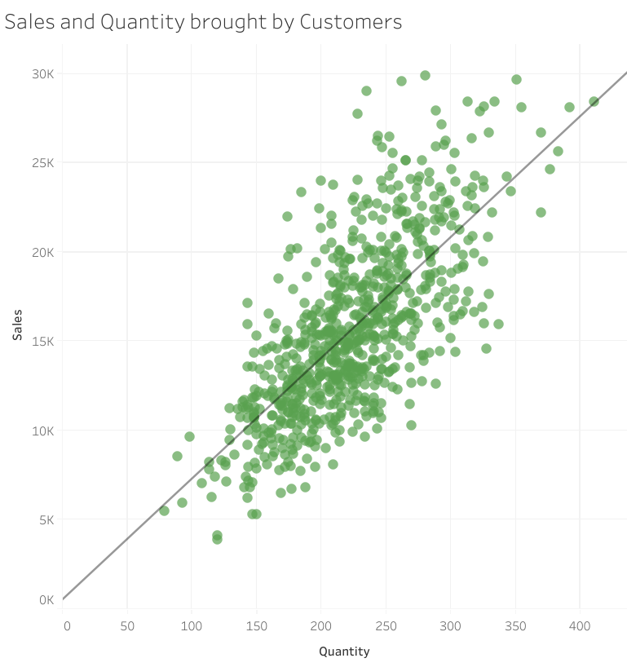
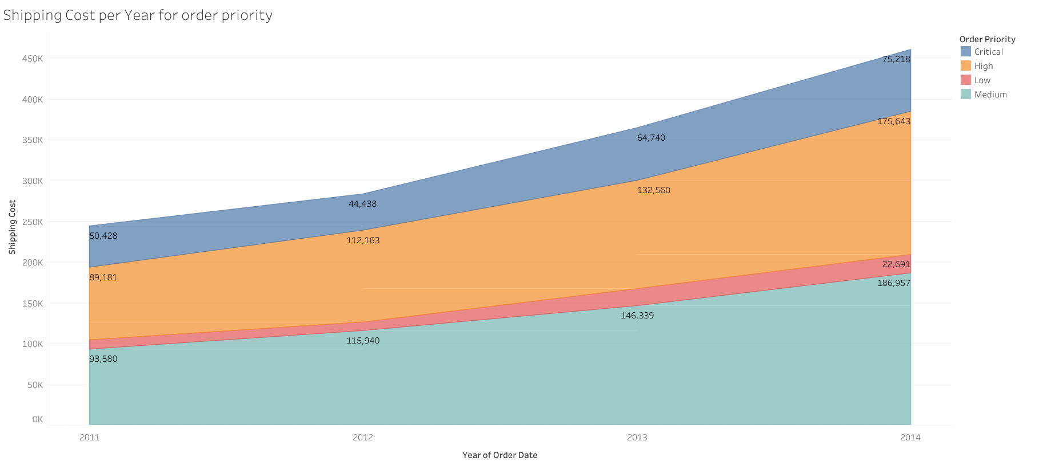
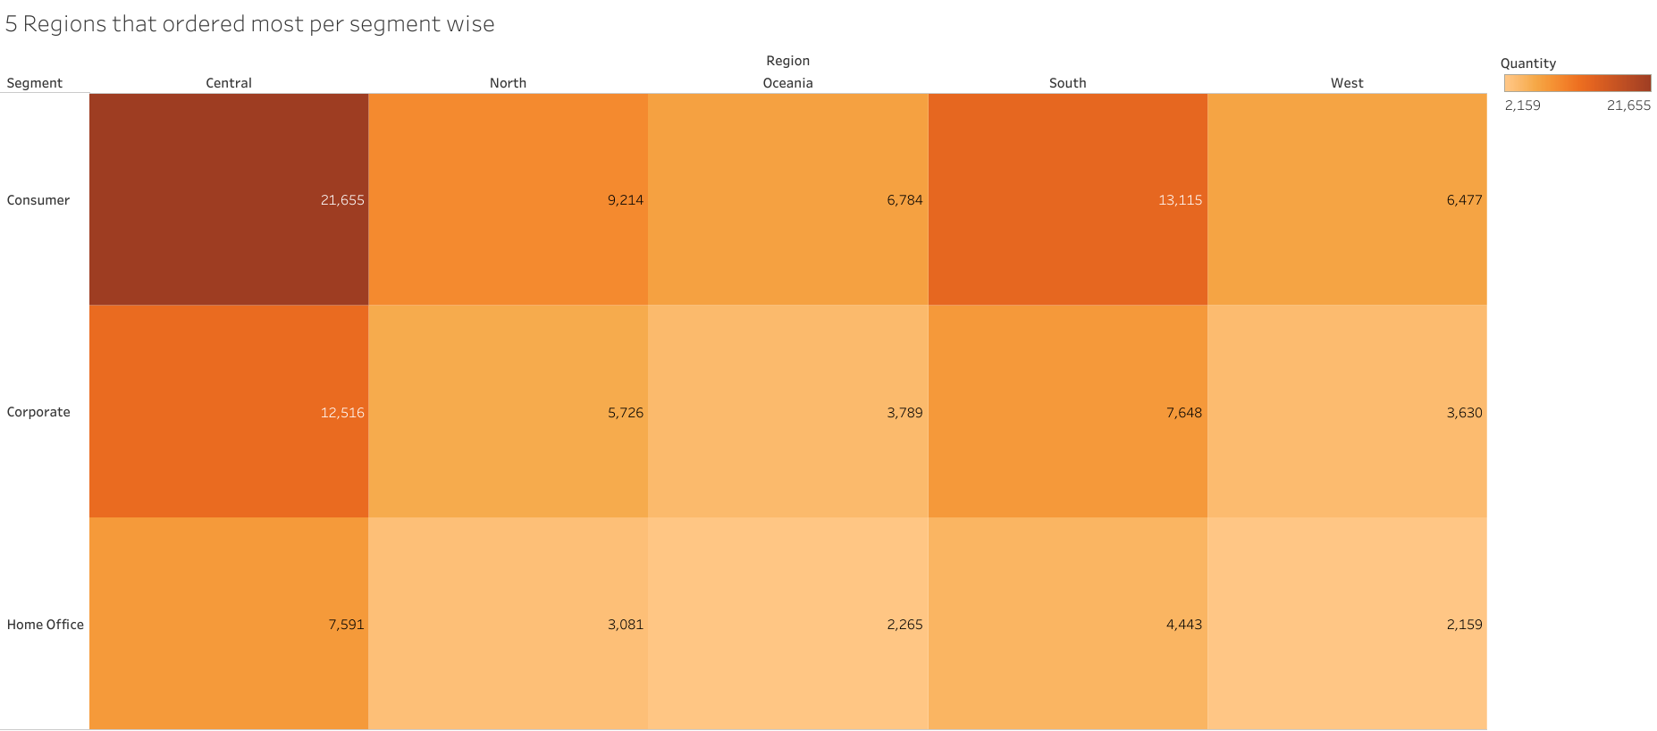
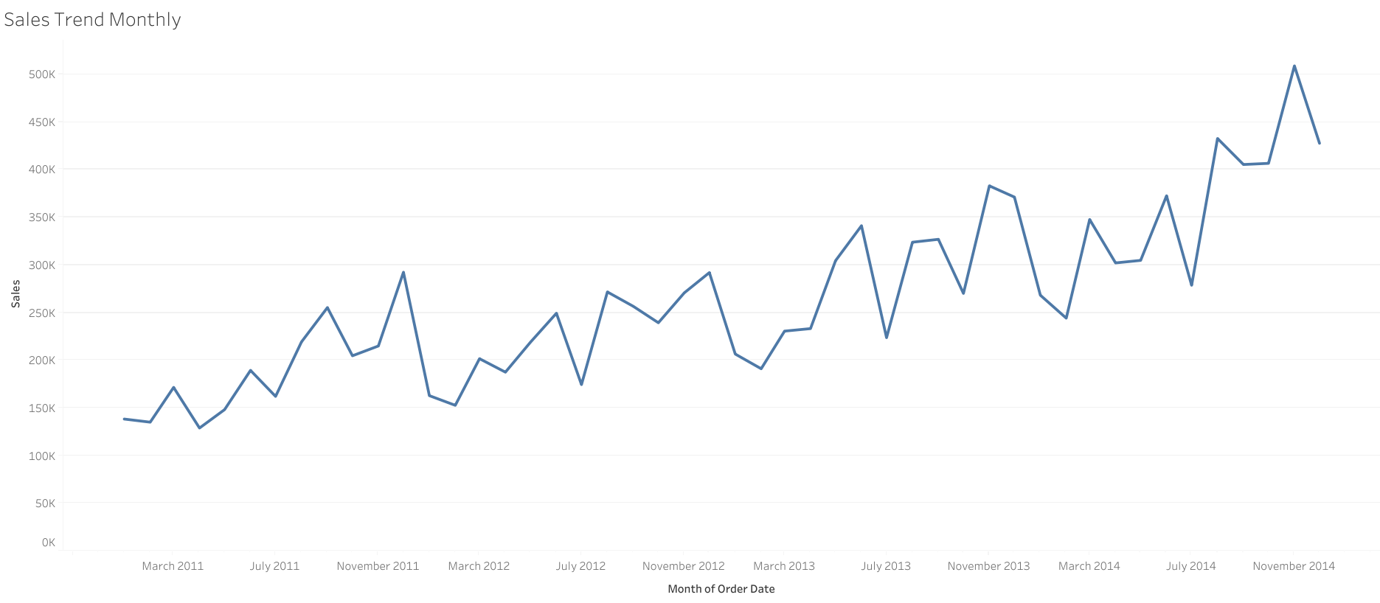

Slide 6
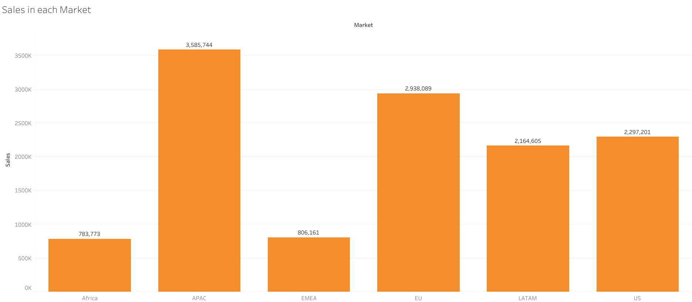
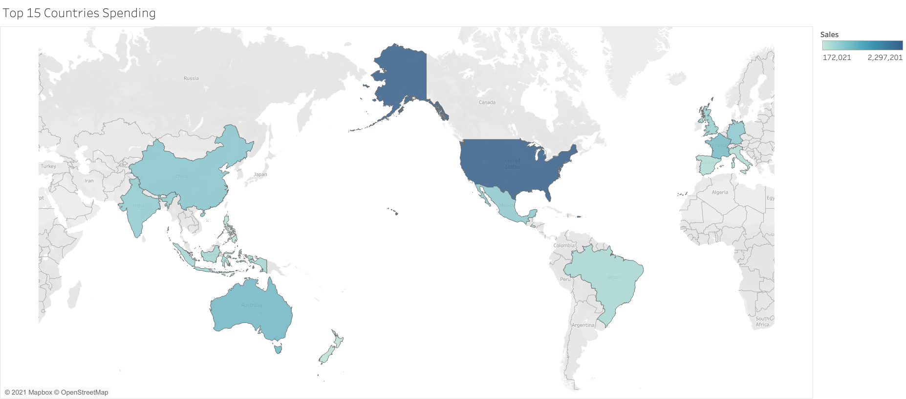

Slide 7
Conclusion
After thorough analysis of the data and the problem statement the superstore is doing a good commerce and yielding good profits.
The sales is increasing each year and expanding in a good pace.
The superstore will make more profit if-
They could lower the shipping cost.
Try to increase sales in countries like India, China and Australia as APAC (Asia-Pacific) market has the highest sales.
Consumer products are ordered highest so it should increase the supply and lower the supply of Home office product as it is least ordered.

Slide 8
Source of tableau file-https://public.tableau.com/views/Final_Project_16240425184310/Sales-Country?:language=en-US&publish=yes&:display_count=n&:origin=viz_share_link

